Slide 1

웹 프로그래밍
한글과컴퓨터학원
조교 이서현

Slide 2
장고
django-admin startproject helloworld

Slide 3
장고
python manage.py makemigrations
python manage.py migrate

Slide 4
장고
helloworld/settings.py
INSTALLED_APPS = [
'django.contrib.admin’,
'django.contrib.auth’,
'django.contrib.contenttypes’,
'django.contrib.sessions’,
'django.contrib.messages’,
'django.contrib.staticfiles’,
'main’,
]

Slide 5
장고
helloworld/settings.py
LANGUAGE_CODE = 'ko-kr’
TIME_ZONE = 'Asia/Seoul'

Slide 6
장고
django-admin startapp main

Slide 7
장고
helloworld/main/templates/main/index.html
<!DOCTYPE html>
<html lang=“ko">
<head>
<meta charset="UTF-8">
<title>Title</title>
</head>
<body>
장고 첫페이지!
</body>
</html>

Slide 8
장고
helloworld/main/views.py
from django.shortcuts import render
# Create your views here.
def index(request):
return render(request,'main/index.html')

Slide 9
장고
helloworld/main/urls.py
from django.urls import path
from . import views
urlpatterns = [ path('', views.index, name='index'), ]

Slide 10
장고
helloworld/helloworld/urls.py
from django.contrib import admin
from django.urls import path, include
urlpatterns = [
path('admin/', admin.site.urls),
path('', include('main.urls')),
]

Slide 11
장고
python manage.py runserver

Slide 12
장고
main
helloworld

Slide 13
장고
main
path('', include('main.urls'))
helloworld/main/
views.py: index
path('', views.index, name='index')
helloworld

Slide 14
장고
main
path(‘main/', include('main.urls'))
helloworld/main/
views.py: index
path(‘hi', views.index, name='index')
helloworld

Slide 15
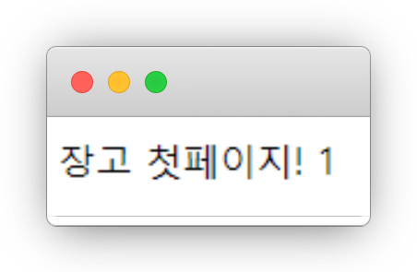
View
localhost:9000/main/hi

Slide 16
장고
main
path(‘main/', include('main.urls'))
helloworld/main/
views.py: index
path(‘hi', views.index, name='index')
helloworld

Slide 17
장고
path
main
re_path
helloworld

Slide 18
장고
Ctrl
C

Slide 19
실습
main
test
…
helloworld

Slide 20
실습
helloworld/urls.py
from django.contrib import admin
from django.urls import path, include
urlpatterns = [
path('admin/', admin.site.urls),
path('', include('main.urls')),
]

Slide 21
View
helloworld/main/views.py
from django.shortcuts import render
# Create your views here.
def index(request):
return render(request,'main/index.html')

Slide 22
View
helloworld/main/views.py
render(request,'main/index.html’, {‘data’: 1})

Slide 23
View
helloworld/main/templates/main/index.html
<!DOCTYPE html>
<html lang=“ko">
<head>
<meta charset="UTF-8">
<title>Title</title>
</head>
<body>
장고 첫페이지!
{{data}}
</body>
</html>

Slide 24
View
localhost:9000/main/hi

Slide 25
실습
현재 시각 출력!

Slide 26
실습
from django.shortcuts import render import datetime # Create your views here. def index(request): return render(request,'main/index.html', {'data':datetime.datetime.now()})

Slide 27
View
helloworld/main/views.py
render(request,'main/index.html’, {‘data’: 1})

Slide 28
MVC 패턴
서버
Request
Response
브라우저

Slide 29
MVC 패턴
서버
조회
생성
Request
Response
수정
브라우저

Slide 30
MVC 패턴
컨트롤러
뷰
모델
생성
조회
수정
브라우저

Slide 31
MVC 패턴
모델
컨트롤러
뷰
데이터 저장
입력 처리
뷰 업데이트
모델 쿼리
예쁘게
보여줌

Slide 32
MVC 패턴
모델
컨트롤러
뷰
Model
View
Template

Slide 33
MVC 패턴
Model
View
Template
???
main/views.py
index.html

Slide 34
MVC 패턴
View
Template
Model
렌더링
브라우저

Slide 35
MVC 패턴
렌더링
View
Template
Model
응답
요청
브라우저

Slide 36
데이터베이스
데이터베이스는 일반적으로 컴퓨터 시스템에 전자적으로 저장되는 구조화된 정보 또는 데이터의 조직화된 모음입니다. 데이터베이스는 일반적으로 데이터베이스 관리 시스템(DBMS)에 의해 제어됩니다.

Slide 37
데이터베이스
데이터베이스는 일반적으로 컴퓨터 시스템에 전자적으로 저장되는 구조화된 정보 또는 데이터의 조직화된 모음입니다. 데이터베이스는 일반적으로 데이터베이스 관리 시스템(DBMS)에 의해 제어됩니다.

Slide 38
데이터베이스
이름
나이
사용자
성별
이메일

Slide 39
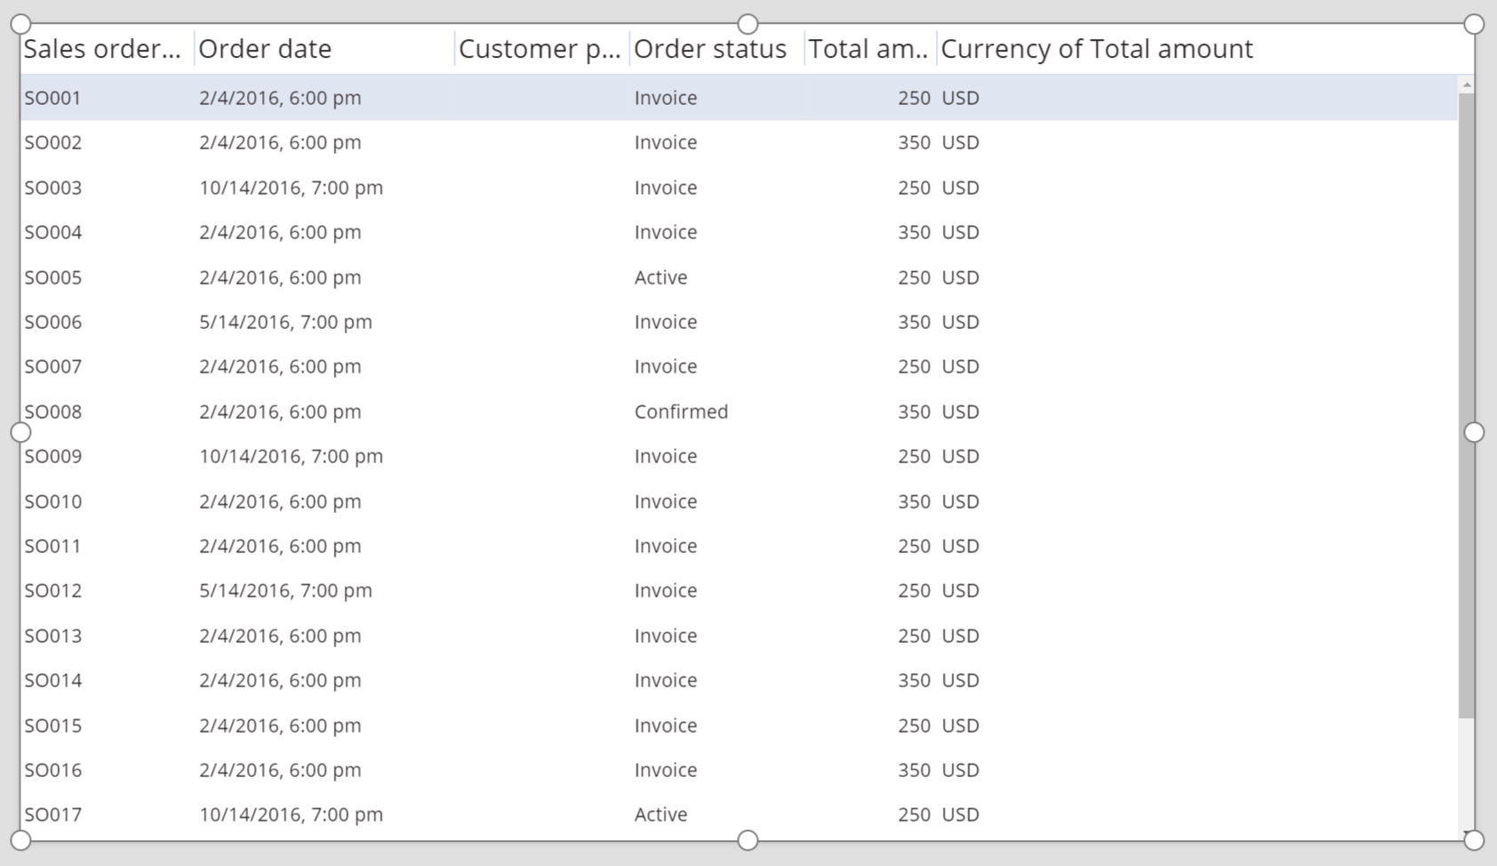
데이터베이스

Slide 40
데이터베이스
DBMS!

Slide 41
데이터베이스
렌더링
View
Template
Model
응답
요청
브라우저

Slide 42
데이터베이스
렌더링
View
Template
DB
Model
응답
요청
브라우저

Slide 43
데이터베이스
python manage.py makemigrations
python manage.py migrate

Slide 44

데이터베이스

Slide 45
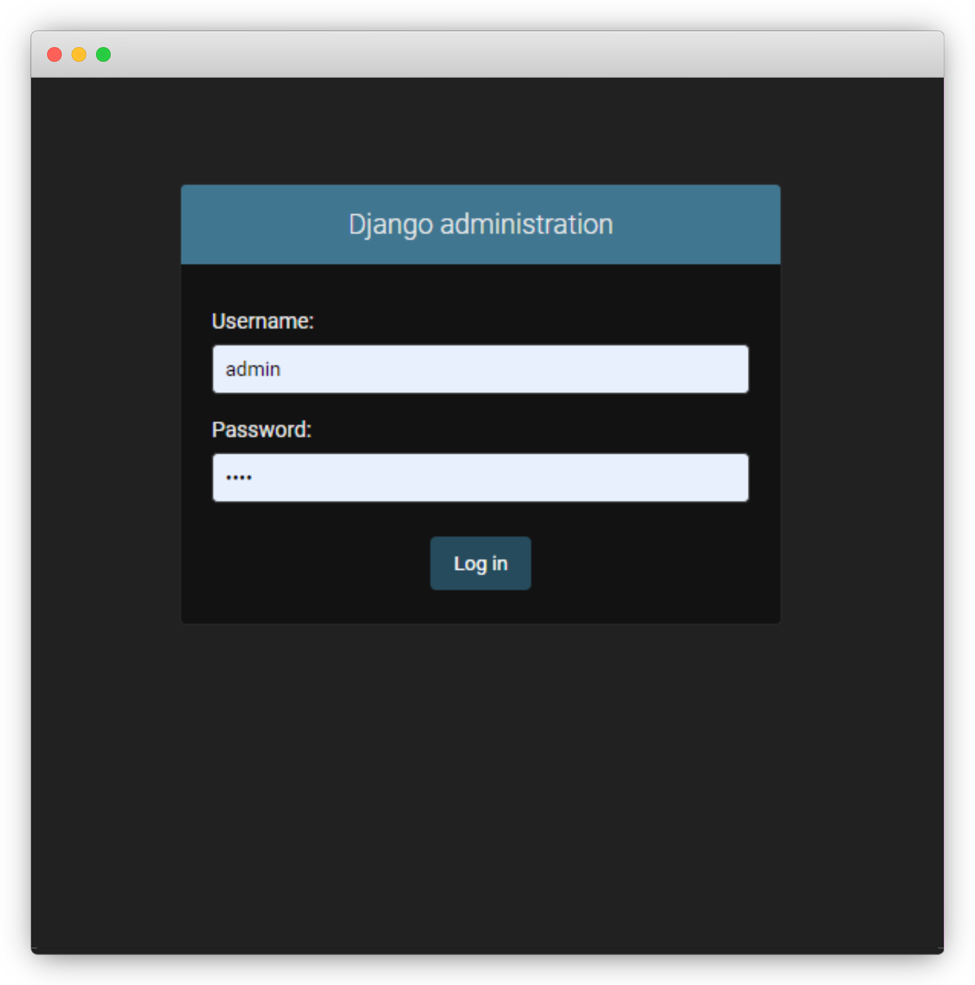
admin
localhost:8080/admin

Slide 46
admin
python manage.py createsuperuser

Slide 47
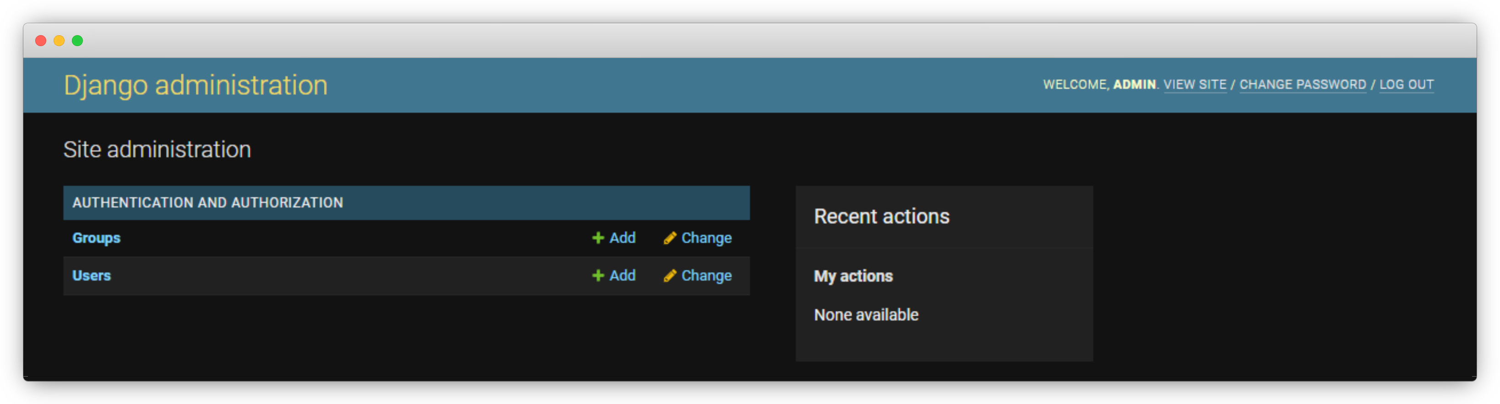
admin
localhost:8080/admin

Slide 48
polls
투표 프로그램!

Slide 49
polls
투표 프로그램!
view
투표 목록
투표
투표 결과

Slide 50
polls
투표 프로그램!
model
Question
Choice
id
id
choice_text
question_text
votes
pub_date
question

Slide 51
polls
Question
Choice
id
integer, NotNull, AutoIncrement, PK
id
integer, NotNull, AutoIncrement, PK
choice_text
varchar(200), NotNull, 답변
question_text
varchar(200), NotNull, 질문
votes
integer, NotNull, 카운트
pub_date
datetime, NotNull, 생성시각
question
integer, Foreign Key, Index

Slide 52
polls
Foreign Key

Slide 53
polls
Foreign Key
다른 데이터와의 연결!

Slide 54
polls
Question
Choice
id
integer, NotNull, AutoIncrement, PK
id
integer, NotNull, AutoIncrement, PK
choice_text
varchar(200), NotNull, 답변
question_text
varchar(200), NotNull, 질문
votes
integer, NotNull, 카운트
pub_date
datetime, NotNull, 생성시각
question
integer, Foreign Key, Index

Slide 55
polls
Choice
question
integer, Foreign Key, Index
Choice
Question
question
integer, Foreign Key, Index
Choice
question
integer, Foreign Key, Index
Choice
question
integer, Foreign Key, Index

Slide 56
polls
helloworld/polls/models.py
class Question(models.Model): question_text = models.CharField('question text', max_length=200) pub_date = models.DateTimeField('date published') def __str__(self): return self.question_text

Slide 57
polls
helloworld/polls/models.py
class Choice(models.Model): question = models.ForeignKey(Question, on_delete=models.CASCADE) choice_text = models.CharField(max_length=200) votes = models.IntegerField(default=0) def __str__(self): return self.choice_text

Slide 58
polls
Choice
class Choice(models.Model): question = models.ForeignKey(Question, on_delete=models.CASCADE) choice_text = models.CharField(max_length=200) votes = models.IntegerField(default=0) def ___str(self): return self.choice_text
id
integer, NotNull, AutoIncrement, PK
choice_text
varchar(200), NotNull, 답변
votes
integer, NotNull, 카운트
question
integer, Foreign Key, Index

Slide 59
polls
Question
class Question(models.Model): question_text = models.CharField('question text', max_length=200) pub_date = models.DateTimeField('date published') def __str__(self): return self.question_text
id
integer, NotNull, AutoIncrement, PK
question_text
varchar(200), NotNull, 질문
pub_date
datetime, NotNull, 생성시각

Slide 60
polls
helloworld/polls/admin.py
from django.contrib import admin from polls.models import Question, Choice # Register your models here. admin.site.register(Question) admin.site.register(Choice)

Slide 61
polls
python manage.py makemigrations
python manage.py migrate

Slide 62
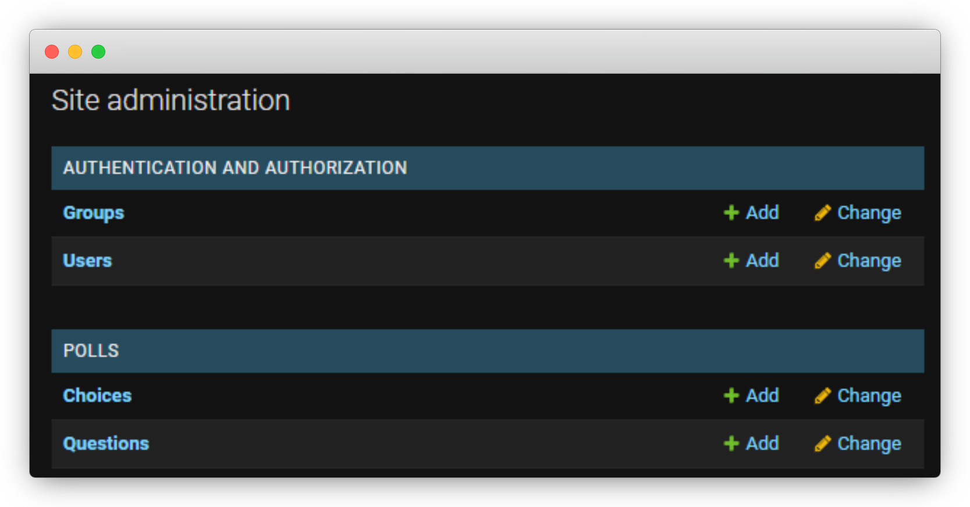
polls

Slide 63
polls
투표 프로그램!
view
투표 목록
투표
투표 결과

Slide 64
polls
투표 프로그램!
view
투표 목록
투표
투표 결과
/polls
/polls/5
/polls/5/vote
/polls/5/result

Slide 65
url
/polls/5/result

Slide 66
url
path(‘???/result’, …)
/polls/5/result

Slide 67
url
path(‘<int:pid>/result’, …)
/polls/5/result

Slide 68
url
path(‘<int:pid>/result’, …)
<형식:변수>

Slide 69
url
path(‘<int:pid>/result’, …)
<형식:변수>
view에 인자로 전달!

Slide 70
url
path(‘<int:pid>/result’, …)
<형식:변수>
str – 문자열(/ 제외)
path – 문자열(/ 포함)
int - 숫자
slug - 슬러그
uuid - UUID

Slide 71
실습
localhost:9000/main/1

Slide 72
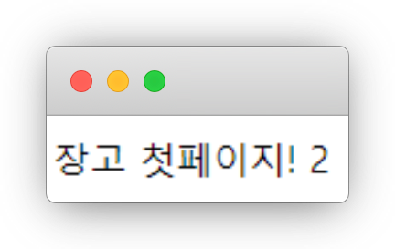
실습
localhost:9000/main/2

Slide 73
실습
helloworld/main/urls.py
from django.urls import path from . import views urlpatterns = [ path('<int:page>', views.index, name='index'), ]

Slide 74
실습
helloworld/main/views.py
from django.shortcuts import render import datetime # Create your views here. def index(request, page=0): return render(request,'main/index.html', {'data':page})

Slide 75
polls
helloworld/helloworld/urls.py
urlpatterns = [ path('admin/', admin.site.urls), path('main/', include('main.urls')), path('polls/', include('polls.urls')), ]

Slide 76
polls
helloworld/polls/urls.py
from django.urls import path from . import views urlpatterns = [ path('', views.index, name='index'), path('<int:question_id>/', views.detail, name='detail'), path('<int:question_id>/vote', views.vote, name='vote'), path('<int:question_id>/results', views.results, name='results'), ] app_name = 'polls'

Slide 77
polls
투표 프로그램!
view
투표 목록
투표
투표 결과
/polls
/polls/5
/polls/5/vote
/polls/5/result

Slide 78
polls
helloworld/polls/views.py
from django.shortcuts import render from polls.models import Question # Create your views here. def index(request, page=0): lastest_question_list = Question.objects.all().order_by('-pub_date')[:5] return render(request, ‘polls/index.html', {'lastest_question_list': lastest_question_list})

Slide 79
polls
Question.objects.all().order_by('-pub_date')[:5]

Slide 80
polls
helloworld/polls/views.py
def detail(request): return render(request, 'polls/detail.html') def vote(request): return render(request, 'polls/vote.html') def results(request): return render(request, 'polls/results.html')

Slide 81
polls
helloworld/polls/templates/polls/index.html
<body> {% if lastest_question_list %} <h2>투표 목록</h2> <ul> {% for question in lastest_question_list %} <li><a href="/polls/{{question.id}}/">{{question.question_text}}</a></li> {% endfor %} </ul> {% else %} <p>등록된 투표가 없습니다.</p> {% endif %} </body>

Slide 82
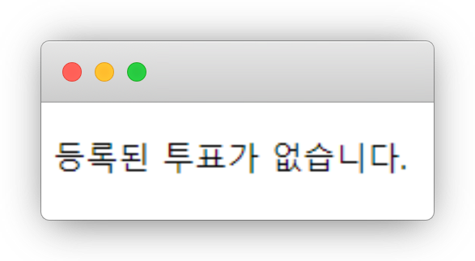
polls
localhost:9000/polls/

Slide 83
polls
localhost:9000/admin

Slide 84
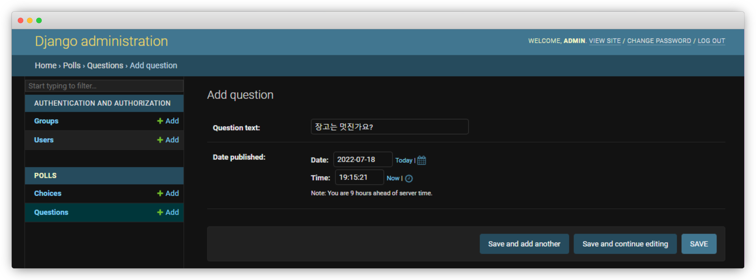
polls
localhost:9000/admin

Slide 85
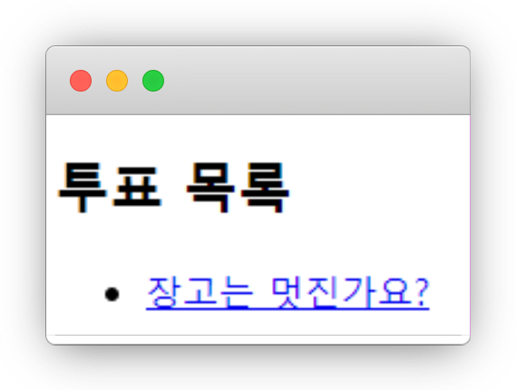
polls
localhost:9000/polls/

Slide 86
polls
helloworld/polls/model.py
def detail(request, question_id): question = get_object_or_404(Question, pk=question_id) return render(request, 'polls/detail.html', {'question': question})

Slide 87
polls
helloworld/polls/templates/polls/detail.html
<h1>질문 : {{question.question_text}}</h1> <form action="{% url 'polls:vote' question.id %}" method="post"> {% csrf_token %} {% for choice in question.choice_set.all %} <input type="radio" name="choice" id="choice{{forloop.counter}}" value="{{choice.id}}" /> <label for="choice{{forloop.counter}}">{{choice.choice_text}}</label> {% endfor %} <input type="submit" value="투표하기"/> </form>

Slide 88
polls
helloworld/polls/urls.py
from django.urls import path from . import views urlpatterns = [ path('', views.index, name='index'), path('<int:question_id>/', views.detail, name='detail'), path('<int:question_id>/vote', views.vote, name='vote'), path('<int:question_id>/results', views.results, name='results'), ] app_name = 'polls'

Slide 89
polls
helloworld/polls/urls.py
polls:vote

Slide 90
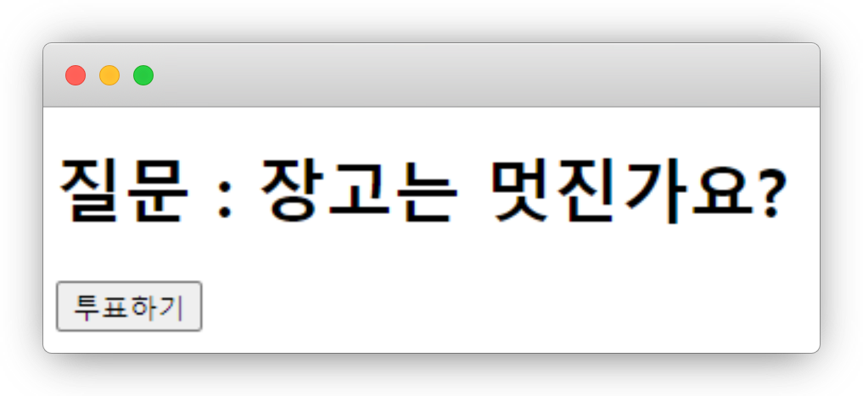
polls
localhost:9000/polls/1

Slide 91
polls
localhost:9000/admin

Slide 92
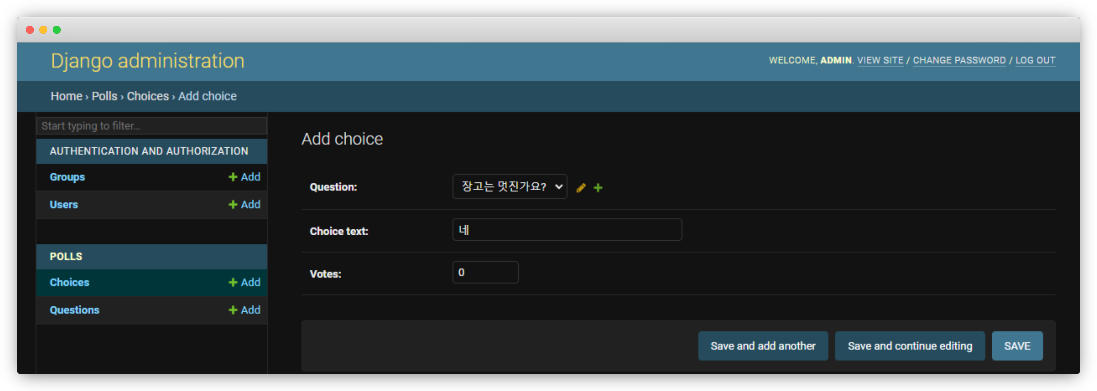
polls
localhost:9000/admin

Slide 93
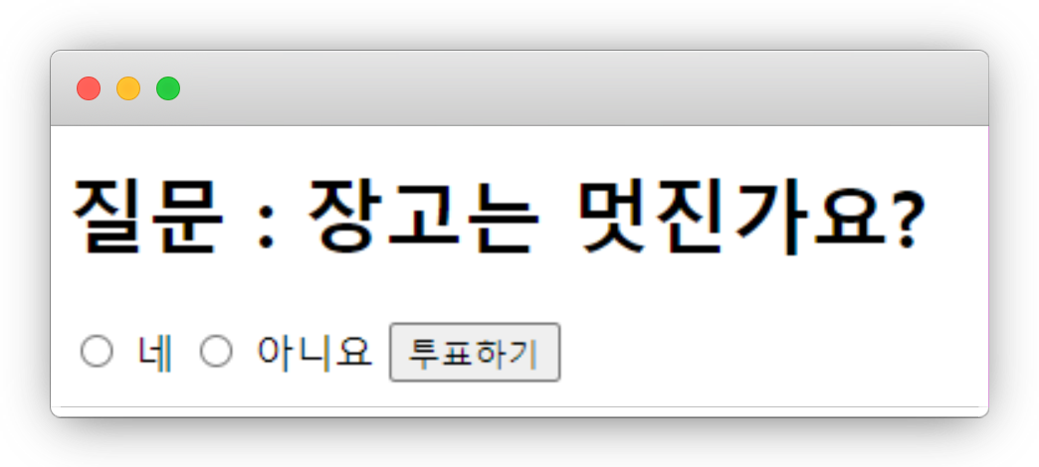
polls
localhost:9000/polls/1

Slide 94
polls
helloworld/polls/views.py
from django.shortcuts import render, get_object_or_404, HttpResponseRedirect, reverse from polls.models import Question, Choice

Slide 95
polls
helloworld/polls/views.py
def vote(request, question_id): question = get_object_or_404(Question, pk=question_id) try: selected_choice = question.choice_set.get(pk=request.POST['choice']) except (KeyError, Choice.DoesNotExist): return render(request, 'polls/detail.html', {'question': question}) else: selected_choice.votes += 1 selected_choice.save() return HttpResponseRedirect(reverse('polls:results', args=(question.id,)))

Slide 96
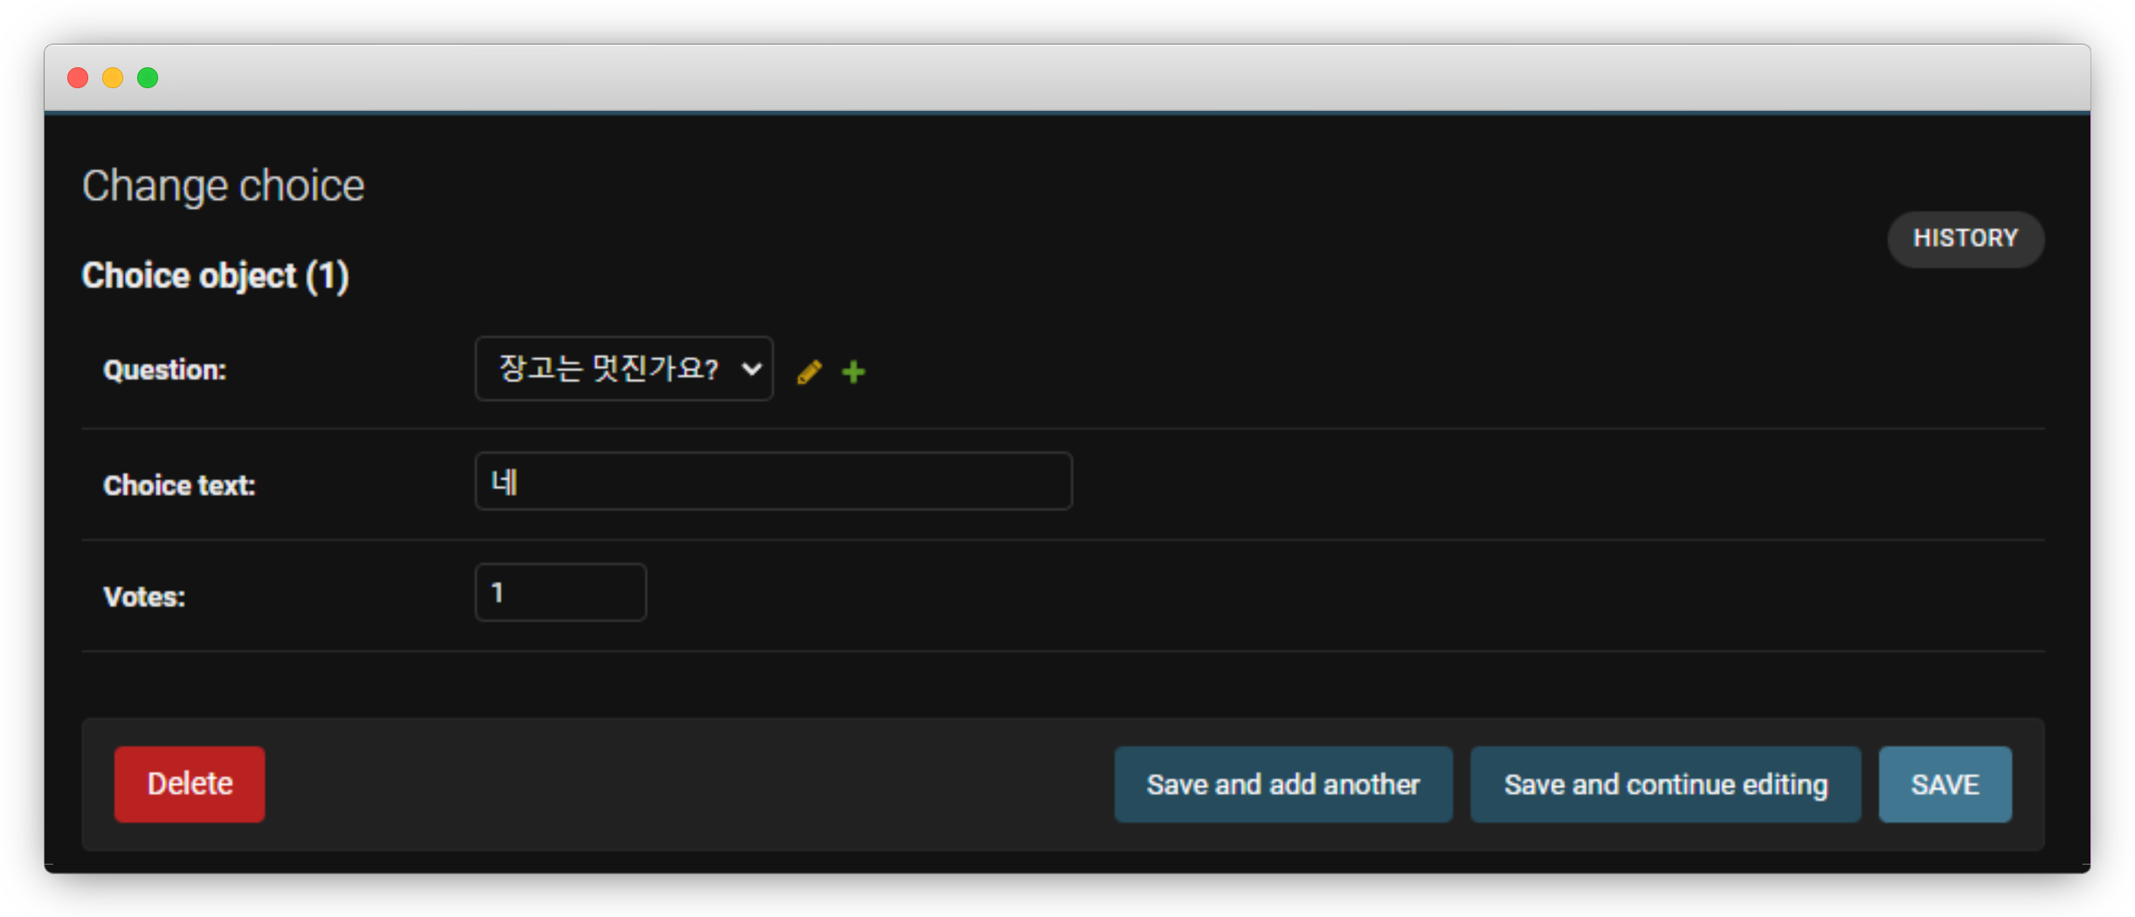
polls

Slide 97
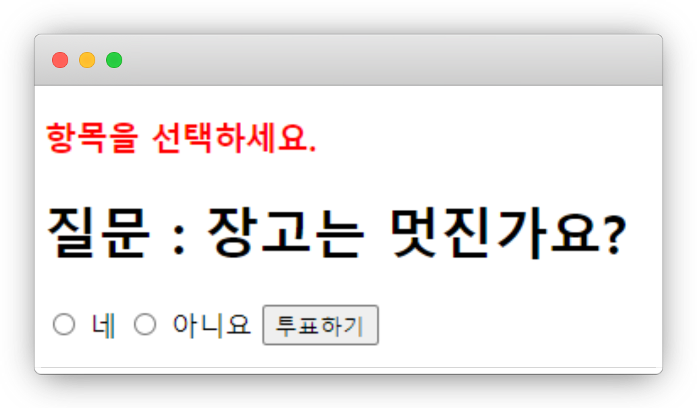
실습
localhost:9000/polls/1/vote

Slide 98
실습
helloworld/polls/views.py
def vote(request, question_id): question = get_object_or_404(Question, pk=question_id) try: selected_choice = question.choice_set.get(pk=request.POST['choice']) except (KeyError, Choice.DoesNotExist): return render(request, 'polls/detail.html', {'question': question, ‘error': ‘항목을 선택하세요.’}) else: selected_choice.votes += 1 selected_choice.save() return HttpResponseRedirect(reverse('polls:results', args=(question.id,)))

Slide 99
실습
helloworld/polls/templates/polls/detail.html
<h3 style="color:red;">{{error}}</h3>
<h1>질문 : {{question.question_text}}</h1> <form action="{% url 'polls:vote' question.id %}" method="post"> {% csrf_token %} {% for choice in question.choice_set.all %} <input type="radio" name="choice" id="choice{{forloop.counter}}" value="{{choice.id}}" /> <label for="choice{{forloop.counter}}">{{choice.choice_text}}</label> {% endfor %} <input type="submit" value="투표하기"/> </form>

Slide 100
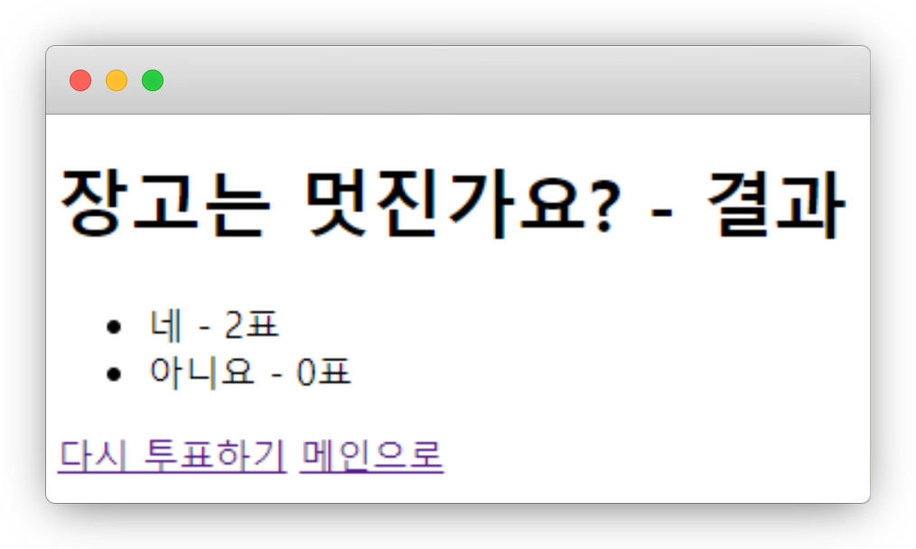
실습
localhost:9000/polls/1/results

Slide 101
실습
helloworld/polls/templates/polls/results.html
<h1>{{question.question_text}} - 결과</h1> <ul> {% for choice in question.choice_set.all %} <li>{{choice.choice_text}} - {{choice.votes}}표</li> {% endfor %} </ul> <a href="{% url 'polls:detail' question.id %}">다시 투표하기</a> <a href="{% url 'polls:index' %}">메인으로</a>

Slide 102
polls
helloworld/polls/urls.py
path('add/', views.add_question, name='add_question'),

Slide 103
polls
helloworld/polls/views.py
def add_question(request): question = Question(question_text=request.POST['question_text'], pub_date=datetime.datetime.now()) question.save() return HttpResponseRedirect(reverse('polls:index'))

Slide 104
polls
helloworld/polls/templates/polls/index.html
{% if lastest_question_list %} <h2>투표 목록</h2> <ul> {% for question in lastest_question_list %} <li><a href="/polls/{{question.id}}/">{{question.question_text}}</a></li> {% endfor %} </ul> {% else %} <p>등록된 투표가 없습니다.</p> {% endif %} <form action="{% url 'polls:add_question' %}" method="post"> {% csrf_token %} <input type="text" name="question_text" value="" /> <input type="submit" value="질문 추가하기"/> </form>

Slide 105
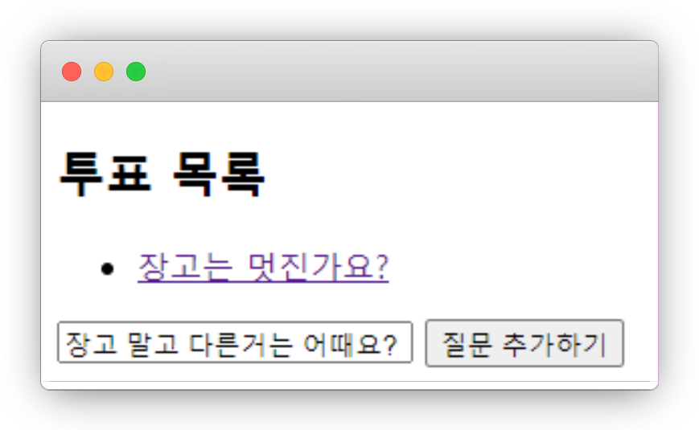
polls
localhost:9000/polls

Slide 106
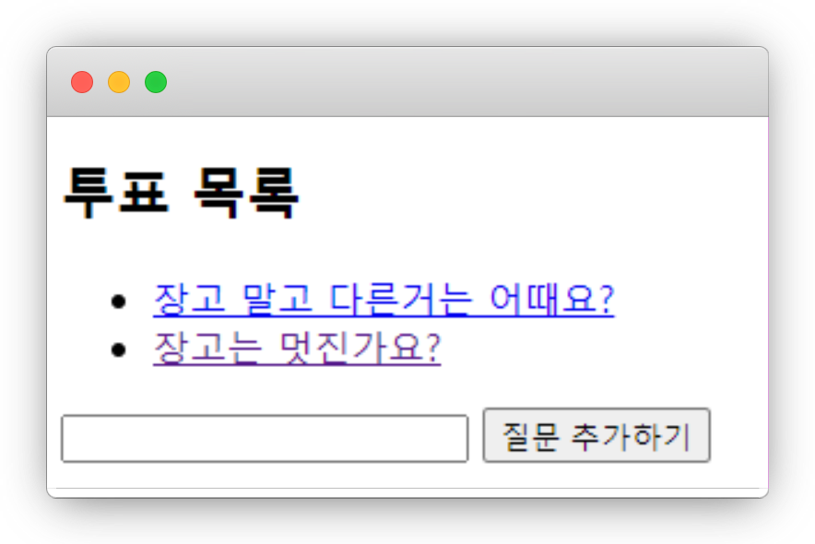
polls
localhost:9000/polls

Slide 107
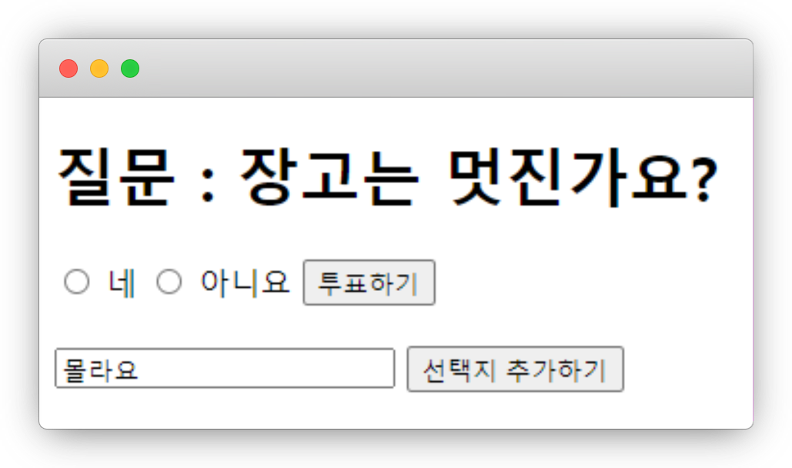
실습
localhost:9000/polls/1

Slide 108
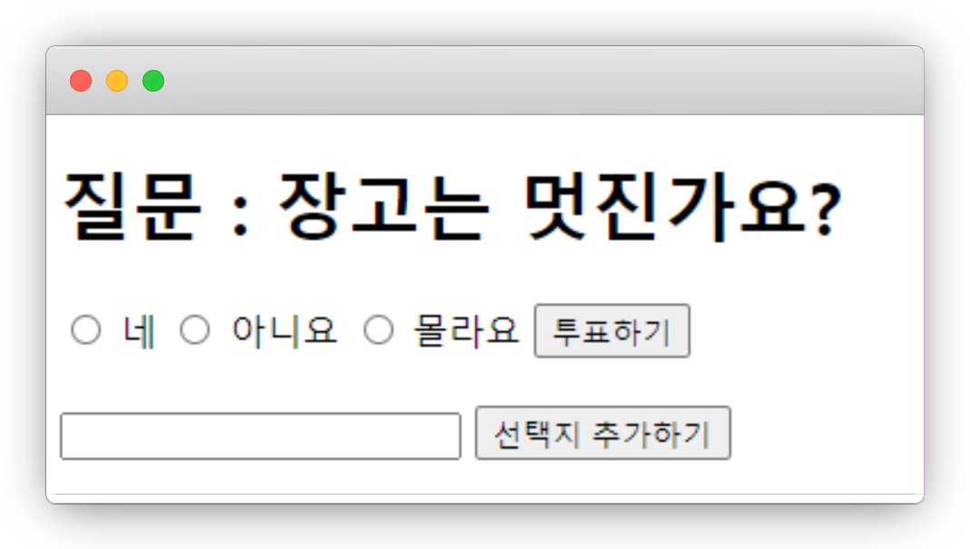
실습
localhost:9000/polls/1

Slide 109
실습
helloworld/polls/views.py
def add_choice(request, question_id): question = get_object_or_404(Question, pk=question_id) choice = Choice(question=question, choice_text=request.POST['choice_text'], votes=0) choice.save() return HttpResponseRedirect(reverse('polls:detail'), args=(question.id,))

Slide 110
실습
helloworld/polls/templates/polls/detail.html
<br> <form action="{% url 'polls:add_choice' question.id %}" method="post"> {% csrf_token %} <input type="text" name="choice_text" value="" /> <input type="submit" value="선택지 추가하기"/> </form>

Slide 111
실습
꾸며보기!

Slide 112
다음 시간에는…
클래스형 뷰

Slide 113
웹 프로그래밍
한글과컴퓨터학원
조교 이서현

